Slide 1
Adding the Buffer to the VFO Just six more parts!
TJ DC RX #4

Slide 2
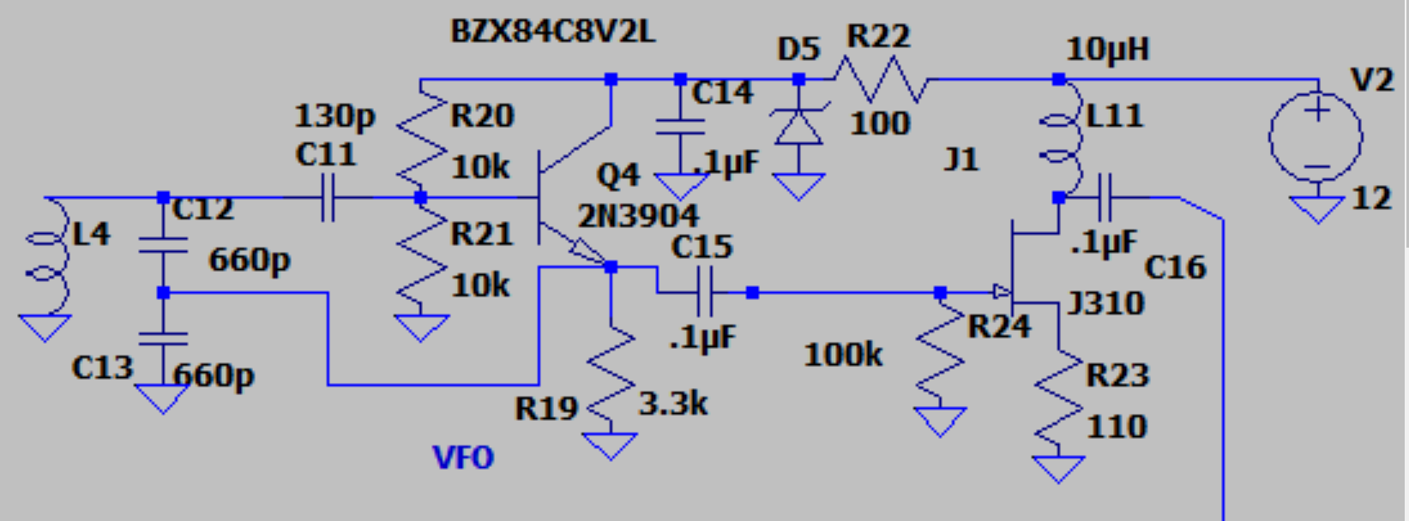
The buffer is an add-on to the VFO

Slide 3
The buffer helps stabilize the VFO
It isolates the VFO from the follow-on stages. And it provides some amplification.
It is built around a Field Effect Transistor. These transistors have a lot of isolation from input to output.
You will use a J310 FET. PINOUT is important! Looking at the flat side of the FET from left to right: Drain Source Gate
Current goes from the Source to the Drain, controlled by the Gate.

Slide 4
You probably already have the pads on your VFO board. If not, add them!

Slide 5
J310 Pinout. When in doubt, Google it!

Slide 6
Building the Buffer
If you haven’t done it already, put a .1uF capacitor from the Emitter of the oscillator to the Gate of the Buffer. Put a 100,000 ohm resistor from the Gate of the Buffer to ground.
Put the 10uH inductor between the 12V line and the Drain of the transistor. Add a wire from the 12V point if you have to.
Put 100 ohms from the Source to Ground. (schematic shows 110, but we have 100 ohms).
Put a .1uF capacitor from the Drain to the Output pad.
Solder in the FET: Drain Source Gate
Check your wiring them test it! First team to confirm mixing to audio wins!

Slide 7
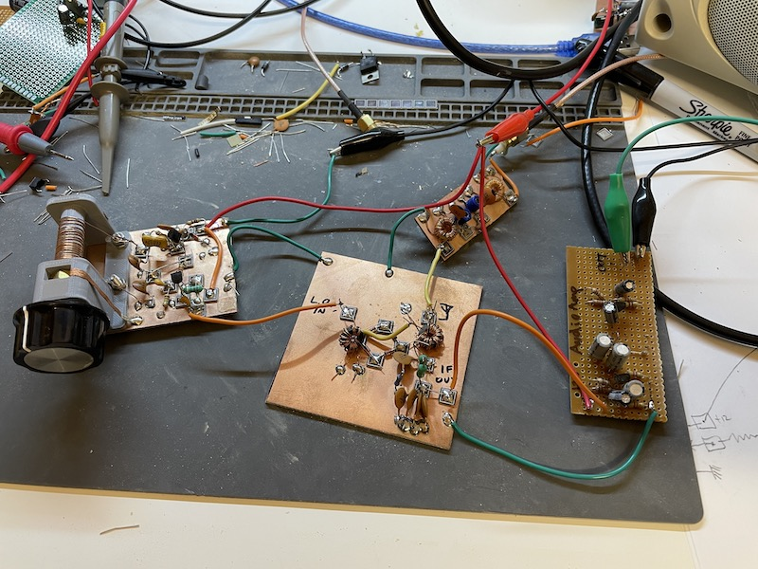
Look familiar? You are not the only ones building this! Sent from Australia yesterday.

